Slide 1
University Event Management System (UEMS)
Project Management Plan
IT 612 – Project Management in IT
Presented by:
Md. Shakil Hossain 472118102
Dafaallh Alrayh Mustafa 472118115
Ajmal Hamidi 472117941
Zayad Aldajan 472117937
Biliaminu Ishola 472117942
Supervised To:
Dr. Shabana Habib
QASSIM UNIVERSITY | College of Computer | Department of Information Technology | 2026

Slide 2
Presentation Agenda
01
Introduction
Project Charter
Scope & Schedule
02
03
Background, Problem Statement & Objectives
SMART Goals, Stakeholders & Constraints
WBS, Gantt Chart & Critical Path
Cost & Quality
Risk & HR
Communication & Procurement
04
05
06
Budget SAR 285K, Standards & Acceptance
12-Risk Register, RACI Matrix & Team
Matrix, Tools, Strategy & Vendors

Slide 3
Introduction & Problem Statement
Organizational Background
Current Problems
• Qassim University – established 2004, Buraidah, KSA
• 60,000+ students; under Ministry of Education
• College of Computer, Dept. of Information Technology
• Programs aligned with Vision 2030 digital economy
• Manages 100s of academic & non-academic events/year
• Scheduling conflicts – no central venue booking
• Communication gaps between organizers & participants
• Budget mismanagement – informal financial tracking
• Inefficient registration – paper-based, time-consuming
• No event history or analytics for decision-making
• Estimated cost: SAR 120,000+/year in lost productivity

Slide 4
Project Charter & SMART Objectives
Sponsor
Duration
Budget
Priority
Qassim University Rector's Office
10 Weeks Feb – Apr 2026
SAR 285,000
HIGH – Strategic Digital Transform.
SMART Objectives
S – Specific
Develop centralized web-based UEMS for Qassim University
M – Measurable
Reduce scheduling conflicts 90% & manual time 75% within 6 months
A – Achievable
Complete planning in 10 weeks using QU IT expertise & infrastructure
R – Relevant
Aligned with QU digital transformation & Saudi Vision 2030 e-governance
T – Time-bound
Full Project Management Plan delivered by April 30, 2026

Slide 5
Scope Management & Work Breakdown Structure
✓ In Scope
✗ Out of Scope
• Event creation & management module
• Participant registration (email/SMS notifications)
• Venue/resource booking with conflict detection
• Budget management with approval workflow
• Attendance tracking (QR-code check-in)
• Post-event feedback & survey module
• Role-based access (Admin/Coordinator/Faculty/Student)
• MyQU portal SSO integration
• Bilingual interface (Arabic & English)
• System testing plan (unit, integration, UAT)
• Actual software coding
• Hardware infrastructure setup
• Post-deployment training
• 3rd-party platform integration
• Mobile app (iOS/Android)
WBS Top-Level Components
• 1.0 Project Management
• 2.0 Requirements
• 3.0 System Design
• 4.0 Development (6 modules)
• 5.0 Integration & Testing
• 6.0 Documentation
• 7.0 Deployment

Slide 6
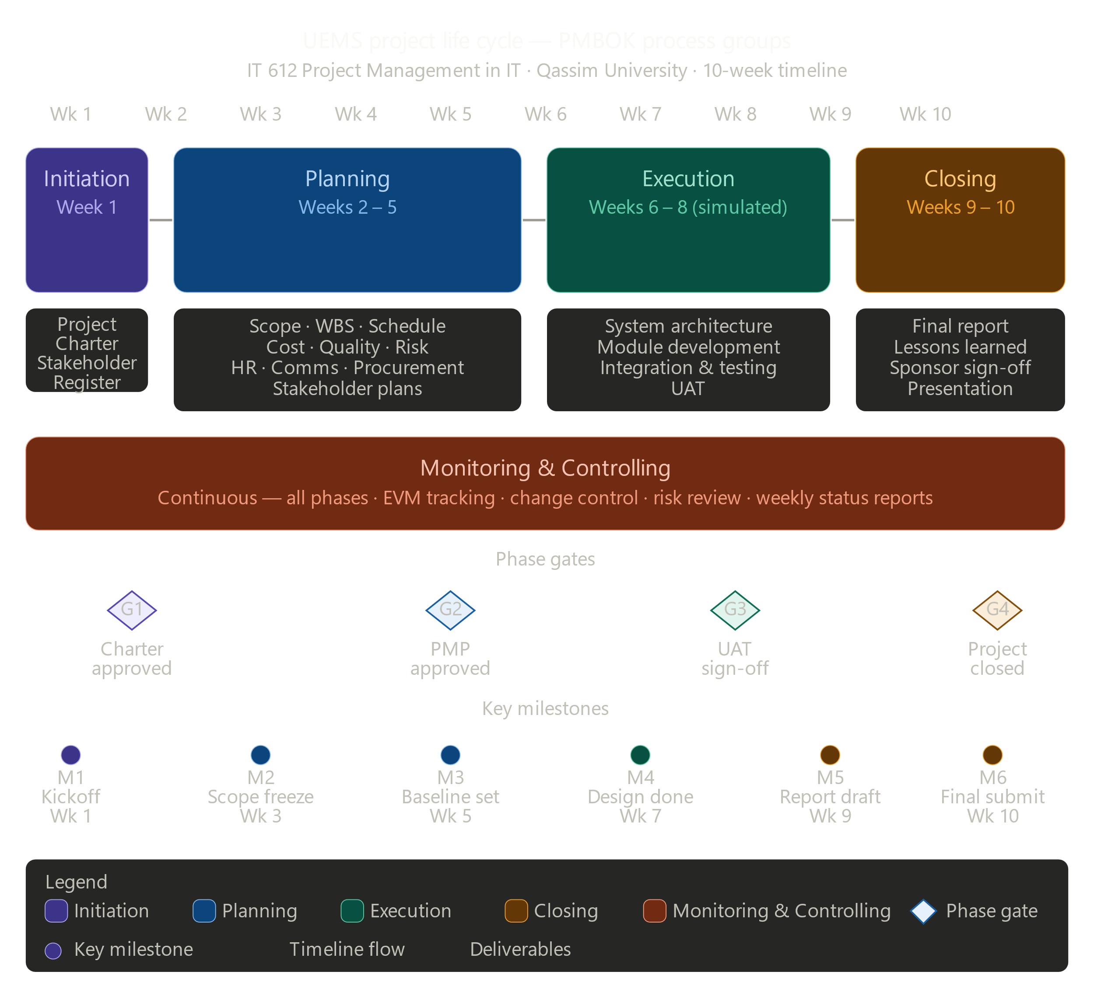
UEMS Life Cycle Diagram

Slide 7
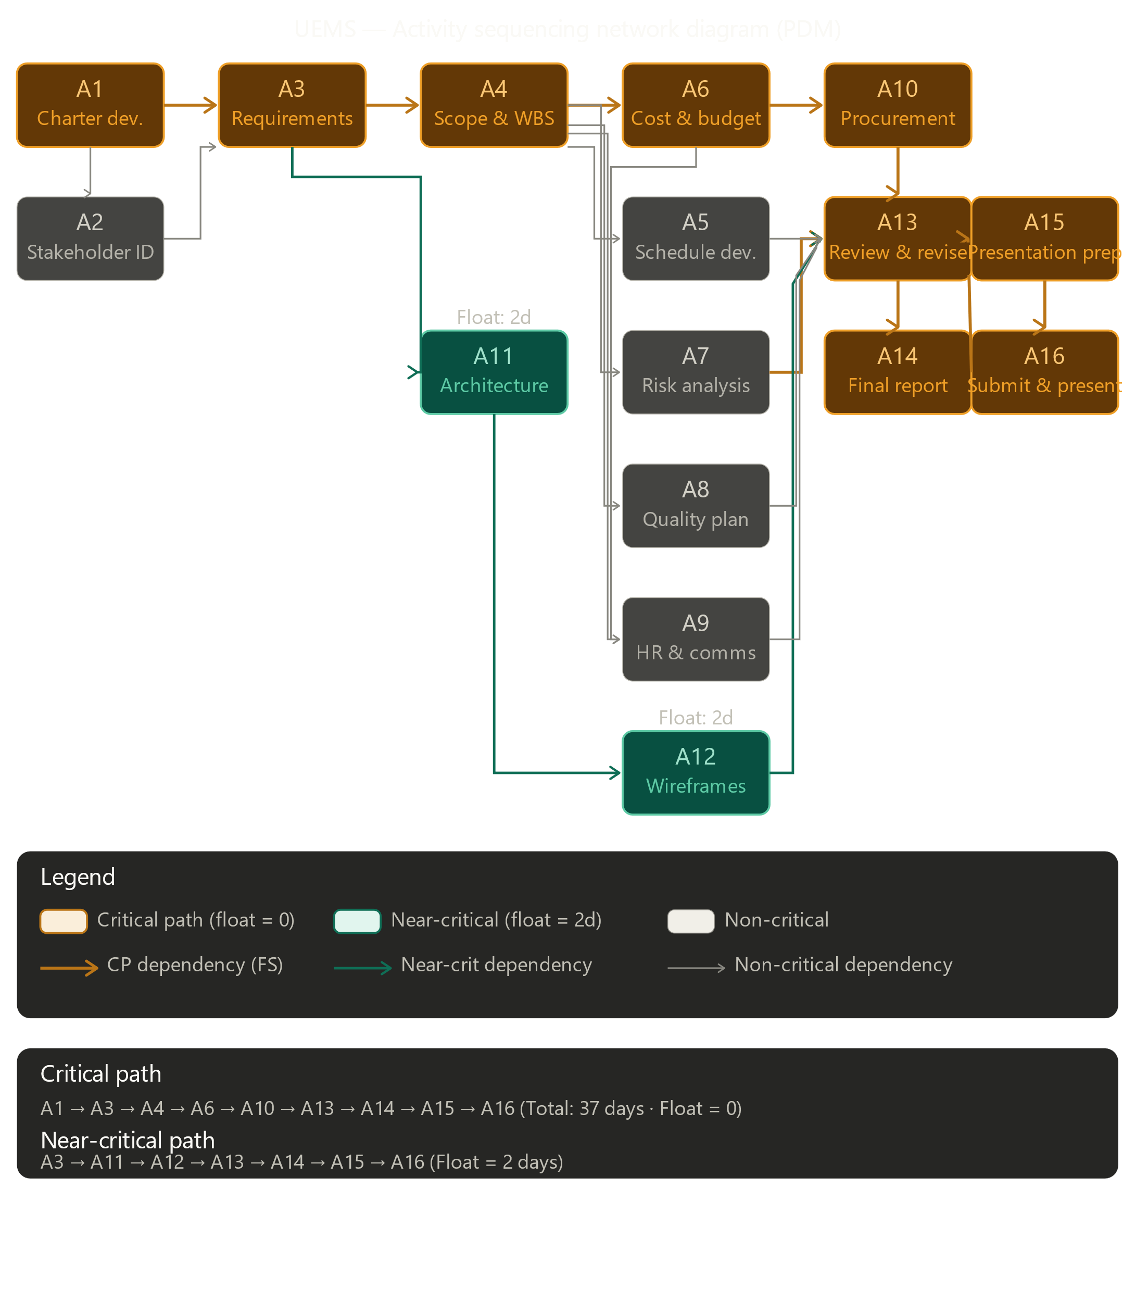
Activity Network Diagram

Slide 8
Schedule Management – Gantt & Critical Path
Activity
W1
W2
W3
W4
W5
W6
W7
W8
W9
W10
Project Charter
Requirements
Scope & WBS
Cost & Budget
Risk Analysis
Architecture Design
Wireframes
Plan Review
Final Report
Submission
Critical Path: A1→A3→A4→A6→A10→A13→A14→A15→A16 | Total Float: 0 | Duration: 37 days | Schedule tracked via EVM (SPI metric)

Slide 9
Cost Management – Budget SAR 285,000
SAR Amount
Cost Item
% of Total
80,000
Project Manager (400 hrs × SAR 200)
28.1%
84,000
Senior Developers ×2 (480 hrs × SAR 175)
29.5%
24,000
Business Analyst (160 hrs × SAR 150)
8.5%
16,800
UI/UX Designer (120 hrs × SAR 140)
5.9%
15,600
QA/Test Engineer (120 hrs × SAR 130)
5.5%
18,000
SMS Gateway API (12 months)
6.3%
9,000
Email Service – SendGrid (12 months)
3.2%
15,000
Cloud Hosting VPS (2 years)
5.3%
4,000
QR Scanner Hardware (×5 units)
1.4%
5,000
UAT Coordination
1.8%
271,400
+10% contingency → SAR 298,540
TOTAL DIRECT COSTS

Slide 10
Risk Management – 12-Risk Register
ID
Risk
Rating
Score
Strategy
R01
Scope change after baseline
High
4×4=16
Enforce change control; freeze scope Wk 3
R02
Key team member unavailable
High
3×4=12
Cross-train team; maintain skills matrix
R03
MyQU portal integration failure
Critical
4×5=20
Early API testing; involve QU IT from Wk 2
R04
Budget overrun – licensing costs
Medium
2×4=8
Prefer open-source; 10% contingency reserved
R05
Late requirements sign-off
High
4×4=16
Hard approval deadlines; early escalation
R06
Data privacy breach in test env.
High
2×5=10
Anonymized test data; NCA ECC controls
R07
Poor user adoption
Medium
3×3=9
Involve users in UAT; conduct training
R08
Vendor delay for QR hardware
Low
2×3=6
Order early Wk 3; identify backup vendor
R09
Technical debt from rushed dev
High
3×4=12
Enforce code review; no-shortcuts policy
R10
Arabic/English miscommunication
Medium
3×3=9
Bilingual minutes & documentation
R11
Scope creep – informal requests
High
4×3=12
Formal change control; stakeholder education
R12
Insufficient testing time
High
3×4=12
Parallel dev/testing; buffer in Wks 8–9

Slide 11
Human Resource & Communication Management
Project Team (Matrix Structure)
Communication Matrix
Project Manager
100%
Weekly Status Report
Overall planning, reporting, stakeholder comm.
Sponsor, IT Head
Sunday Email + SharePoint
Business Analyst
75%
Team Stand-up Meeting
Requirements gathering, WBS, scope docs
Project Team
Monday 9AM – MS Teams
Lead Architect
60%
Phase Gate Review
System architecture, tech selection, design
All Stakeholders
Senior Developer A
End of phase – In-person
100%
Risk Log Update
Event, Registration & Database modules
PM + Leads
Senior Developer B
100%
Bi-weekly SharePoint
Budget, Attendance, Feedback & API modules
Change Request Notif.
Relevant Parties
UI/UX Designer
80%
As needed – Email/CRF
Wireframes, prototypes, bilingual design
Student/Faculty Bulletin
QA/Test Engineer
All QU Users
100%
Monthly – MyQU Portal
Test planning, execution, UAT coordination
Final Presentation
IT Infrastructure
25%
All Stakeholders
Week 10 – In-person
Server setup, network, deployment env.

Slide 12
Stakeholder Management – Power/Interest Grid
KEEP SATISFIED
MANAGE CLOSELY
Engagement Strategies
Manage Closely
QU Finance Dept. NCA (Regulator)
Rector's Office IT Dept. Head QU IT Infrastructure
Weekly status meetings, direct involvement in phase gates, proactive issue escalation, dedicated relationship log
HIGH POWER
Keep Satisfied
Monthly summary reports, formal compliance docs, engagement at milestones and financial/regulatory approvals
MONITOR
KEEP INFORMED
Keep Informed
Monthly MyQU bulletins, UAT participation, feedback surveys, active input in requirements & testing
External Vendors
Students Faculty Members Event Coordinators
LOW POWER
Monitor
Procurement processes and contract performance management; updates only as relevant to deliverables
LOW INTEREST
HIGH INTEREST

Slide 13
Conclusion
Comprehensive Plan
Strategic Alignment
Measurable Outcomes
Covers all 13 PMBOK knowledge areas. Includes Charter, WBS, Gantt chart, cost baseline, quality standards, RACI matrix, 12-risk register, procurement plan & stakeholder engagement strategy.
UEMS directly supports Qassim University's digital transformation & Saudi Vision 2030 e-governance goals. Replaces fragmented manual processes with a centralized, bilingual, role-based digital platform.
90% reduction in scheduling conflicts. 75% reduction in manual processing time. SAR 120K+ annual savings expected. ROI within 18 months of deployment. System uptime ≥ 99.5%.

